Slide 1
What to correct? How to correct? Why to correct?
Focus on Form with Multilingual Writers
Jennifer MacDonald
@JenMac_ESL
jennifermacdonald.ca

Slide 2

“My paper looks like it’s bleeding!”

Slide 3
Definitions
L1: first language
L2: second or additional language
Multilingual students/writers: students who use English as a second/additional language

Slide 4
Focus on form/grammar
Explicit instruction, correction or feedback on:
  Grammar
  Syntax = structure of phrases and sentences
  Lexis = vocabulary
  Morphology = structure of words, e.g. suffix, prefixes, word endings (-s, -ing, etc.)
  Spelling
  Punctuation

Slide 5
Language Rules
Constitutive
Regulatory

Slide 6
Grammar vs. style
“Grammar — the principles constituting the syntactically and morphologically permissible expressions of a language — is not at all the same thing as style.
Style involves skill. It involves making choices between alternatives that the grammar makes available. Those choices can make the difference between using the language brilliantly or using it ploddingly.”
Pullum, G. K. (2004). Ideology, power, and linguistic theory. Conference presentation given at Modern Language Association Annual Meeting. Philadelphia. Retrieved from http://ftp.ling.ed.ac.uk/~gpullum/MLA2004.pdf

Slide 7
Prescriptivism
“A doctrine that holds certain features of a language to be incorrect and in need of replacement by other forms deemed correct on the grounds of logic, existence in classical or older forms of a language or use by ‘good’ writers.”
Prescriptivism (2004). In J. Swann et al., A dictionary of sociolinguistics. Edinburg, United Kingdom: Edinburgh University Press

Slide 8
What is sociolinguistics?
An orientation to the study of language that stresses the inter-relationship between language and social life, rather than focusing narrowly on language structure.
Sociolinguistics (Sociolinguistic). (2004). In J. Swann et al., A dictionary of sociolinguistics. Edinburg, United Kingdom: Edinburgh University Press.

Slide 9
Language varieties
Each has its own set of constitutive rules
Varieties can be defined by region (Regional dialects), social groups (African American Vernacular), context of use (Academic English)
Standard varieties have been codified and are used in schooling and the media
Linguistically equal
Any differences in status between varieties is not linguistically rooted; it’s societal inequalities being projected onto the varieties associated with certain groups

Slide 10
Grammar Correction Debate
The Case Against Written Corrective Feedback: Truscott (1996)
“[Many instructional, correction and feedback practices appear] to be guided by the underlying premise that students are able to correct/learn all the errors pointed out by the teacher.
Such an approach, however, does not take account of the developmental stage [in terms of cognitive path of second language acquisition] of individual students and is unlikely to be effective because for some errors, students may simply lack the [developmental] readiness to correct them.
”
Lee, I. (2013). Research into practice: Written corrective feedback. Language Teaching, 46(01), 108-119.
Truscott, J. (1996). The case against grammar correction in L2 writing classes. Language Learning, 46(2), 327–369.

Slide 11
Grammar Correction Debate
“Over-emphasis on WCF as a means to enhance students’ written accuracy may, […] short-circuit students’ writing development.” (in terms of creativity, risk-taking, etc.) (Lee, 2013)
Lee, I. (2013). Research into practice: Written corrective feedback. Language Teaching, 46(01), 108-119.

Slide 12
Grammar Correction Debate
Focused correction (correcting every instance of an error - comprehensive)
  vs. Unfocused correction (correcting only certain instances of errors – intensive)
Direct correction (saying what the error is and where)
  vs. Indirect correction (giving “hints” to what/where the error is)
Treatable errors (rule-governed - grammar, etc.)
  vs untreatable errors (Non-rule-governed - word choice, style, etc.) (Ferris 2002)
Ellis, R. (2009). A typology of written corrective feedback types. ELT journal,63(2), 97-107.

Slide 13
Recommendations for WCF
Give indirect WCF to treatable errors (i.e. errors that students are able to self-correct because they are rule-governed) (Ferris 2001)
Give direct feedback to untreatable errors (errors that are not amenable to self-correction, such as word choice and word order) (Ferris 2001)
Students of lower language proficiency are likely to benefit from direct WCF (Ferris & Roberts 2001).
Error codes (indirect feedback) may not be helpful if teachers use the codes for grammar items that students have not yet mastered (Lee 1997; Ferris 2002).
Keep error codes short, and limited to items that students are actually able to fix
Overall, it may be best to use a combination of direct and indirect WCF to suit different learners, writing tasks and error types.

Slide 14
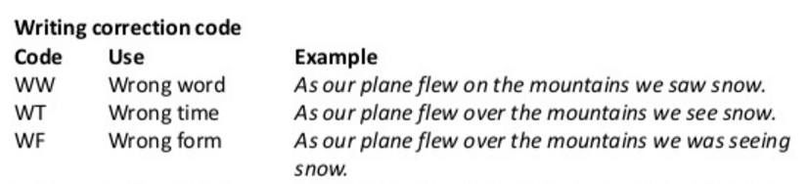
Put thought into error correction codes
This is not helpful! Is “wrong word” a:
Word choice/lexical error (choosing between synonyms?)
An errors of register/formality/discipline?
Is it a collocation error, where a word is dictated by the word(s) it pairs with? (E.g. at the park vs. on the bus?
A grammar error? (E.G. using the wrong article)?

Slide 15
Linguistic Diversity in Canada
English is L1 of approximately 19 million Canadians (57% of the population)
French is L1 of 22% of Canadian population
Languages other than English or French are L1 of 21% of Canadian population
28 million people in Canada reported using English as their dominant language
(source: 2011 Census)

Slide 16
Linguistic Diversity at Canadian Universities
In 2014 there were 89 000 full time international students at Canadian universities
11% of undergraduates and 28% of graduate students are international in Canada
How many at your institution?
Universities Canada (2014) Quick Facts on Internationalization at Canadian Universities. Retrieved from: http://www.univcan.ca/universities/facts-and-stats/internationalization-at-canadian-universities-quick-facts/

Slide 17
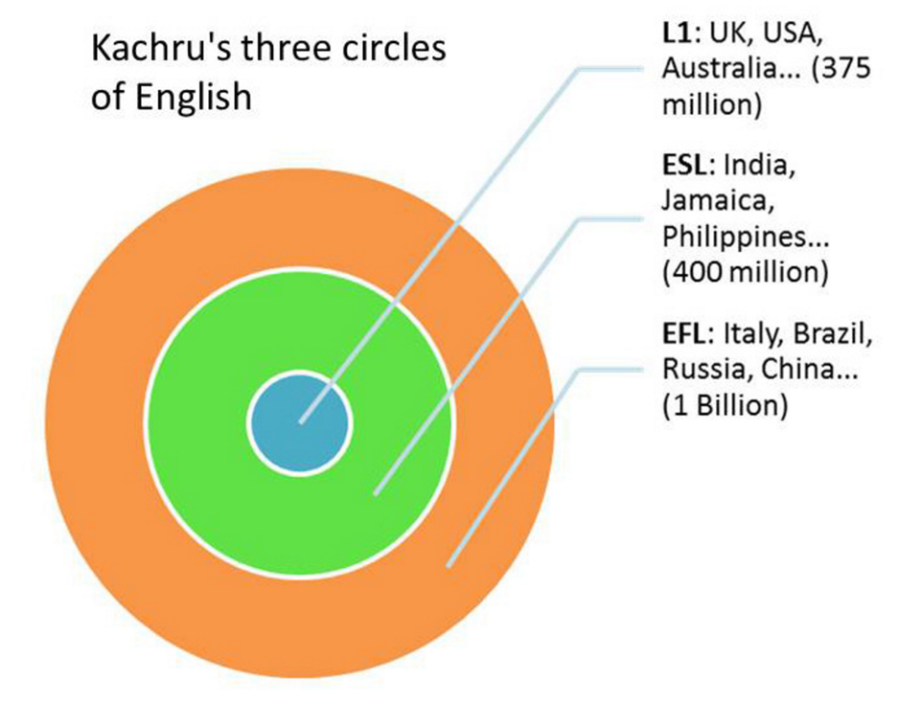
Three Circles of English (Kachru, 1992)
INNER CIRCLE
+Canada!
OUTER CIRCLE
EXPANDING CIRCLE
Kachru, B. B. (1992). The other tongue: English across cultures. University of Illinois Press.

Slide 18
Student Preferences
“Surveys of student opinion about teacher feedback have consistently affirmed the importance that L2 students place on receiving grammar correction from their teachers (Cohen, 1987; Ferris, 1995b; Hedgcock & Lefkowitz, 1994; Leki, 1991; Radecki & Swales, 1988). Though Truscott argues that although “students believe in correction...that does not mean that teachers should give it to them” (1996, p. 359)”
Ferris, D. (1999). The case for grammar correction in L2 writing classes: A response to Truscott (1996). Journal of Second Language Writing, 8(1), 1–11. http://doi.org/10.1016/S1060-3743(99)80110-6

Slide 19
What makes good writing?
Accuracy of grammar, spelling and punctuation
Accuracy of and variety in word choice
Variety and complexity in sentence structure
Clear organization and structure of text
Coherence and flow
Clear argument and logic
Suitability of register, genre and adherence to disciplinary conventions
Appropriate use of evidence, examples, etc. from source material
Appropriate use of citation and referencing practices

Slide 20
Investigating the relationship between the use of English for academic purposes and academic attainment
Method:
  Using the diagnostic language assessment procedure known as Measuring the Academic Skills of University Students (MASUS²), as well as informal analysis of assignment feedback and interviews with students, students' performance in assignments in three subject areas was investigated.
Results:
  Results confirmed that there was a strong correlation between the overall scores students obtained in the MASUS language assessment and their attainment as represented by their assignment grade.
  However, analysis of the five separate categories of the MASUS scores showed that only the scores for the category, use of source material, correlated strongly with student attainment and that the scores on the more explicit language categories, structure and development of the text, academic writing style, and grammar, did not.
  Donohue, J. P., & Erling, E. J. (2012). Investigating the relationship between the use of English for academic purposes and academic attainment. Journal of English for Academic Purposes, 11(3), 210–219. http://doi.org/10.1016/j.jeap.2012.04.003

Slide 21
Should we spend so much time on grammar?
“The student said [to language teacher, about courses in their discipline/degree-program]:
  ‘This was written for Dr Oades. I put endings on verbs and nouns for you, but he gives me a B without them. (Johns, 1988: 57)’”
Johns, A. M. (1988). The discourse communities dilemma: Identifying transferable skills for the academic milieu. English for Specific Purposes,7(1), 55-59.

Slide 22
What to do?
Change of mindset?
Move from procedural knowledge of academic writing to metalinguistic and sociolinguistic declarative knowledge of language
Foster “socio-literacy” in yourself, your marking team and your students.
Move from role of writing specialist to language specialist
  Johns, A.(1997). Text, role, and context: Developing academic literacies. Cambridge: Cambridge University Press.

Slide 23
Deficit View vs. Strengths View
“Academic language […] is no one’s mother tongue” (Bourdieu et al., 1994, p. 8)”
Bourdieu, P., Passeron, J.-C., & Martin, M. D. S. (1994). Academic Discourse: Linguistic Misunderstanding and Professorial Power (1 edition). Stanford, Calif: Stanford University Press.

Slide 24
Grammar of Choice
“Far from being a linguistic straightjacket, grammar is a flexible, incredibly rich, system that enables proficiency speakers to express meaning in a way appropriate to the context, to how they wish to present themselves, and to the particular perspective they wish to contribute. Although accuracy is an issue in grammar, so is meaningfulness and appropriateness of use.”
Larsen-Freeman, Diane. (2009). Teaching and testing grammar. In M. Long and C. Doughty (Eds.) The Handbook of Language Teaching (pp. 518-542). Malden, MA: Blackwell.

Slide 25
Grammar of Choice
“If Trump won the election, I’d eat my hat.”
“If Trump wins the election, I’ll eat my hat.”
What’s the difference in meaning?
How does choosing one over the other contribute to how you position yourself?
Lots of other examples in: Larsen-Freeman, Diane. (2009). Teaching and testing grammar. In M. Long and C. Doughty (Eds.) The Handbook of Language Teaching (pp. 518-542). Malden, MA: Blackwell.

Slide 26
Dealing with linguistic variation
How do you respond if a student writes the following:
My neighbor told me the product is available in various colors.
It was a difficult situation but I did the needful.

Slide 27
Practical Suggestions
Build declarative knowledge of
  both constitutive and regulatory rules
  sociolinguistics of English in use both globally and locally
Great text to understand influence of multilingual writers’ L1:
  Swan, M., & Smith, B. (2001). Learner English: A Teacher’s Guide to Interference and Other Problems. Cambridge University Press.

Slide 28
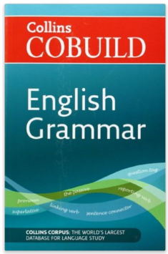
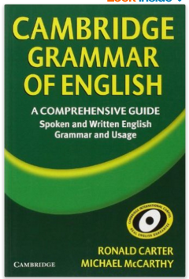
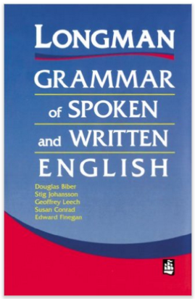
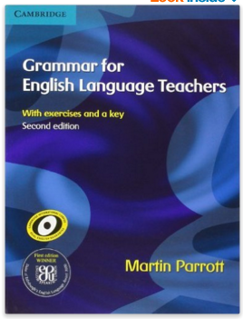
Corpus-based English Grammars
Longman Grammar of Written and Spoken English
Cambridge Grammar of English
Collins COBUILD English Grammar
Grammar for English Language Teachers

Slide 29
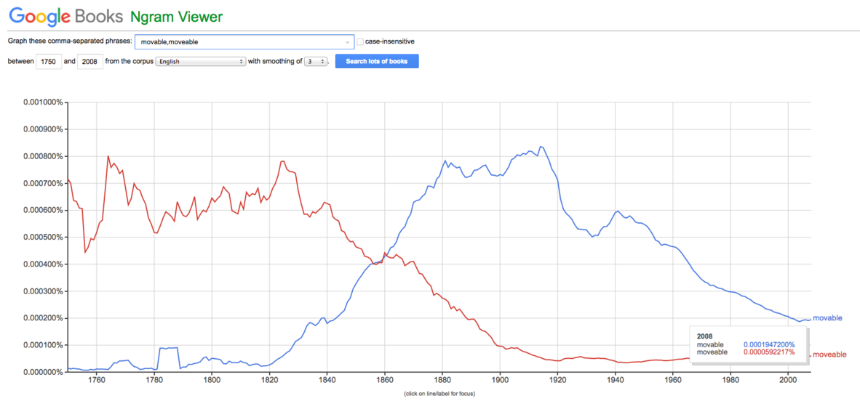
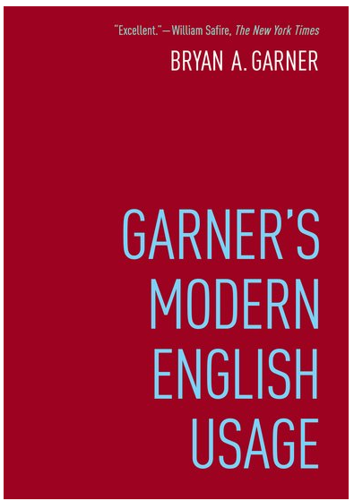
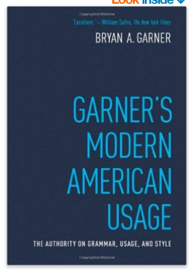
Garner’s Modern English/American Usage (2016)
Graphic from: http://www.businessinsider.com/bryan-garner-interview-english-usage-google-ngrams-big-data-2016-4

Slide 30
Consciously Constructing Assignments:
How much does grammar matter?
Dealing with Language – Pre-Writing
Consciously Constructing Assignments
Defining Values and Marking Criteria
Best practice:
For each writing assignment, clearly define focus and values, and develop a clear rubric to guide both students and markers

Slide 31
Treatment of Error in Second Language Student Writing: Major Issues
Teacher preparation
Grammar for ESL teaching
Practice in identifying written error and giving feedback
Practice in developing and presenting mini-lessons on grammar and editing strategies
Error treatment
Teacher feedback that is sensitive to student needs and instructional context
Consciousness-raising about importance of accuracy and editing strategies
Strategy training
Mini-lessons
Practice and accountability
From Ferris, D. R. (2004). The “Grammar Correction” Debate in L2 Writing: Where are we, and where do we go from here? (and what do we do in the meantime …?). Journal of Second Language Writing, 13(1), 49–62.

Slide 32
Socio-literate choices
“[An] understanding of when or why to use a particular grammatical form should be part of an [English] teacher’s understanding of grammar so as to avoid the teacher’s giving students easy answers in the moment that contribute to confusion later on and so that students understand that they have a choice and what the consequences are of making that choice.”
Larsen-Freeman, Diane. (2009). Teaching and testing grammar. In M. Long and C. Doughty (Eds.) The Handbook of Language Teaching (pp. 518-542). Malden, MA: Blackwell.

Slide 33
Thank you!
Jennifermacdonald.ca
@JenMac_ESL

