Slide 1
ESL Workshops for International Students:
Canadian Culture and Language
Jennifer MacDonald
Head Teacher, ESL Programs

Slide 2
Today’s Objectives
To take a brief look at how Canadian English has been influenced by the history and culture of Canada
To become more familiar with the unique features of spoken and written Canadian English so that you better understand and use it

Slide 3
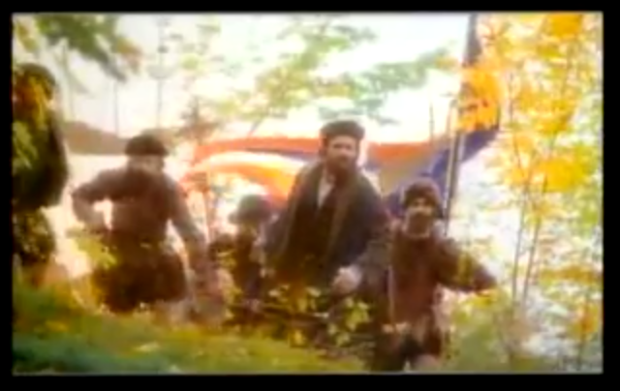
How did Canada get its name?
https://www.youtube.com/watch?v=O1jG58nghRo

Slide 4
Activity #1
RACE!
How fast can you list the 10 Canadian provinces and 3 territories, and their capitals?

Slide 5
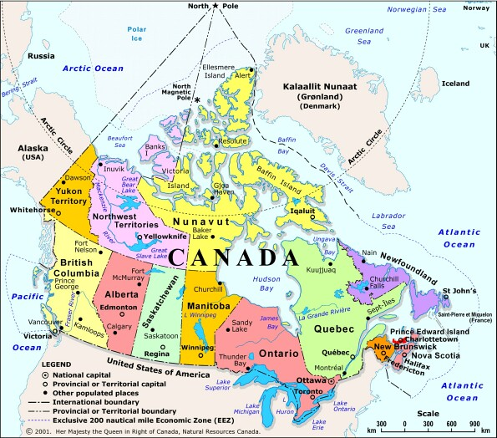
Source:
http://members.shaw.ca/kcic1/mapmenu.html

Slide 6
Facts About Language in Canada
What percentage of Canadians are anglophone?
What percentage of Canadians are francophone?
How many aboriginal languages are there?
What percentage of Canadians speak a language other than English or French at home?
57%
22%
65
20%

Slide 7
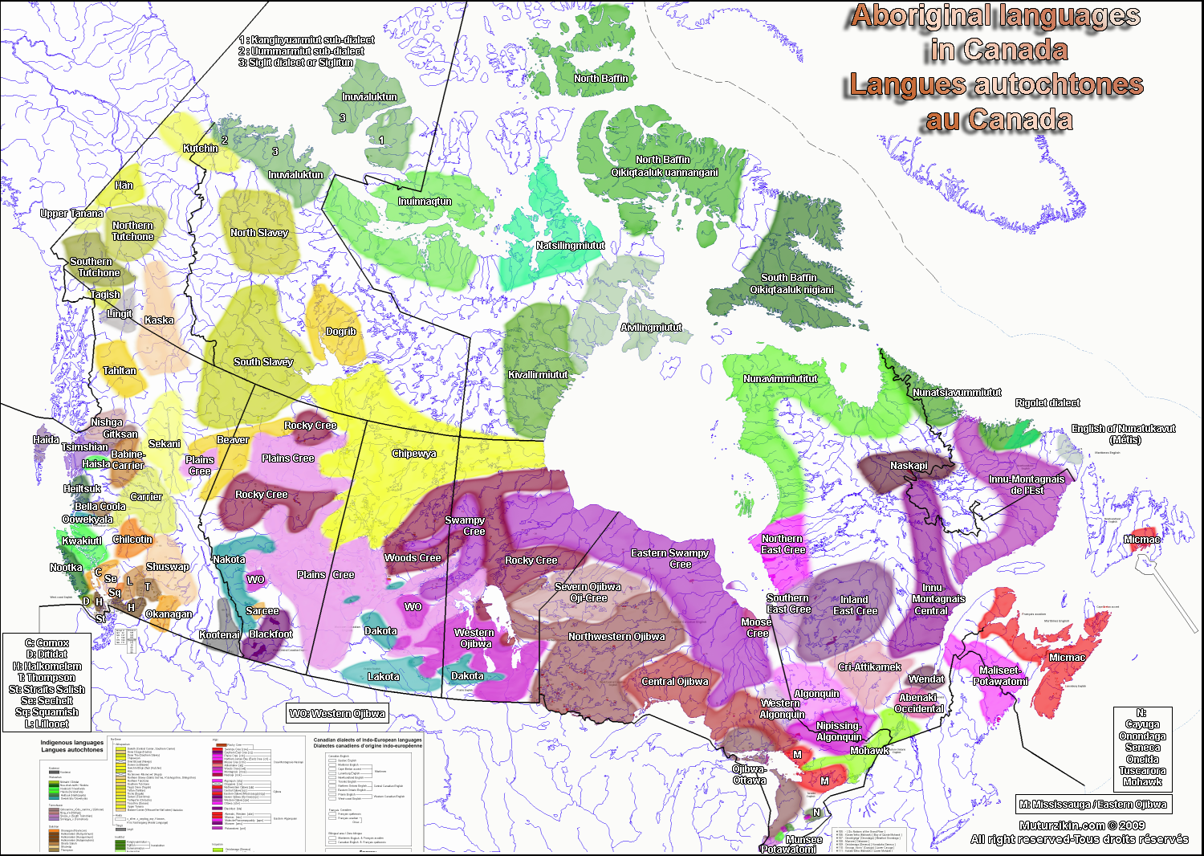

Slide 8
Nova Scotian Pronunciation Lesson
Many place names are of Mi’kmaw origin that have been anglicized
How do you pronounce the following?
Antigonish Chebucto Kejimkujik National Park
Merigomish Musquodoboit Harbour
Pictou Shubenacadie
Stewiacke Tatamagouche
Whycocomagh

Slide 9
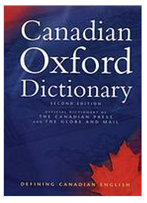
Canadian Vocabulary
There are different types of Canadian words
  Uniquely Canadian words and terms
  Words used in Canada that are different than the words used in the US or Britain
  See handout for some examples

Slide 10
Canadian Spelling
As in vocabulary, Canadian spelling is a mix of American and British influence
In your writing, choose US, UK or Canadian English (in Microsoft Word), but BE CONSISTENT

Slide 11
Most Common Spelling Differences
Most common differences:
  our: honour (Can) vs. honour (US)
  -re: centre (Can) vs. center (US)
  Doubled final consonants: travelled (Can) vs. traveled (US)
  -ize: organize (Can) vs. organise (UK)
  program (Can, US) vs. programme (UK)
  catalogue (Can, UK) vs. catalog (US)
  cheque (Can, UK) vs. check (US)

Slide 12
Canadian Spelling
Reading, handout, activity #3

Slide 13
Pronunciation
Very little variation in pronunciation across the country
Canadian pronunciation sounds very similar to Western USA
Some notable differences: Newfoundland, Cape Breton, etc.

Slide 14
Canadian Pronunciation: “EH”
The uniquely Canadian “tag question”
Handout, activity #4
Link: http://www.yorku.ca/twainweb/troberts/raising.html

Slide 15
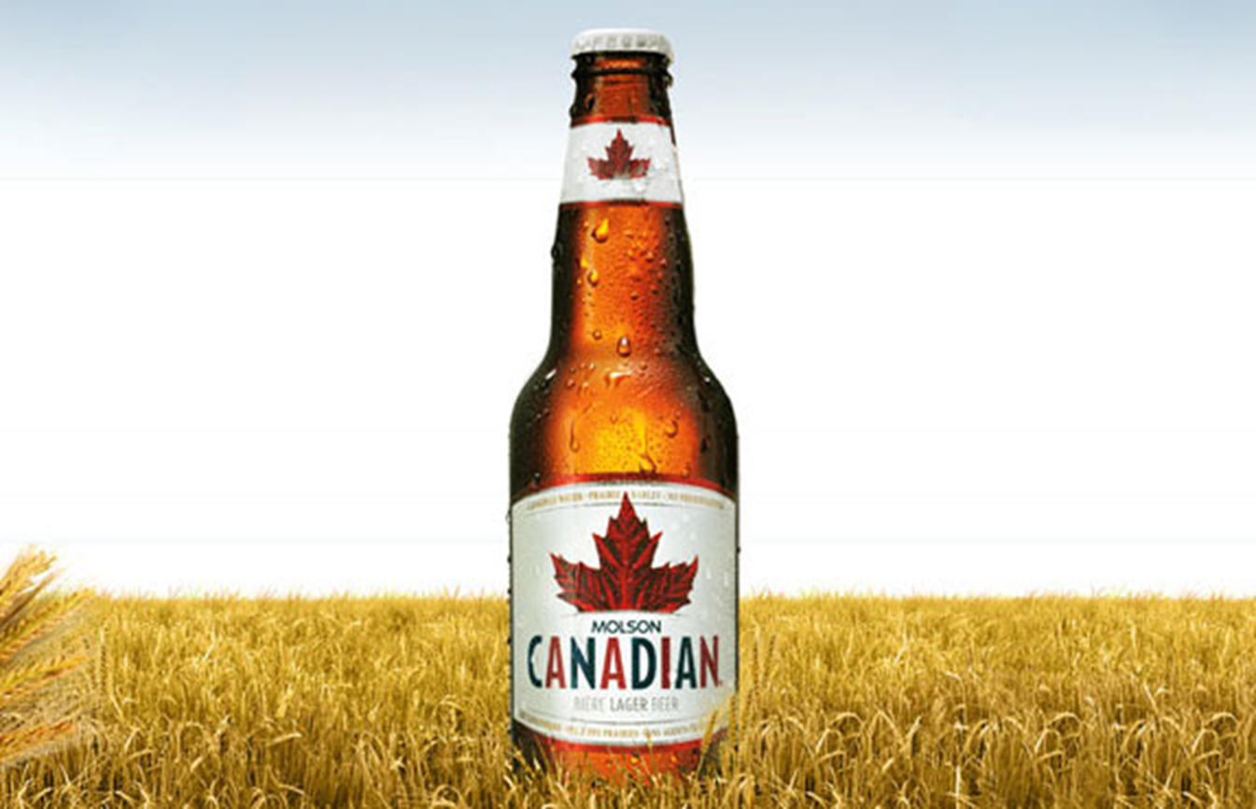
Discussion: I am Canadian
https://www.youtube.com/watch?v=WMxGVfk09lU

Slide 16
Important Days and Culture
The Monday preceding May 24
July 1
First Monday of September
Second Monday of October
November 11
December 26

Slide 17
Thank You!
My contact info: jennifermacdonald@dal.ca
www.dal.ca/esl

